Slide 1
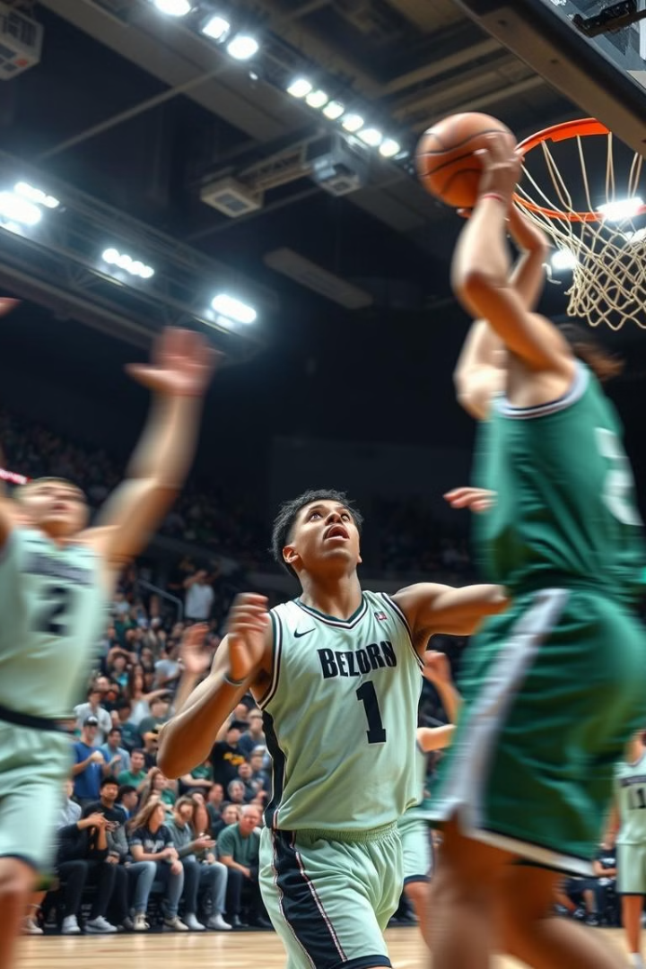
NBA Draft Simulation: An SQL-Powered Bidding Interface
This presentation explores the development of a novel NBA player bidding interface utilizing SQL, a powerful tool for managing and querying data.
by Luis Riviere, Saketh Kilaru, Akshaj Salvi, Ishaan Lodhi

Slide 2
Leveraging SQL for Team Management
Data Integrity
Dynamic Queries
SQL ensures accuracy and consistency of data, managing players, teams, and budgets seamlessly.
Enforces constraints to prevent errors, such as exceeding budget limits or drafting too many players.
SQL can handle complex data relationships, enabling us to simulate drafts with 60 players and 20 teams while maintaining performance.
The same framework can scale for larger drafts or other sports leagues.
Teams can analyze player performance, rank players based on stats and evaluate budget usage in real-time.
SQL queries make it easy to sort players by position, availability, or rank, helping teams prioritize their selections.

Slide 3
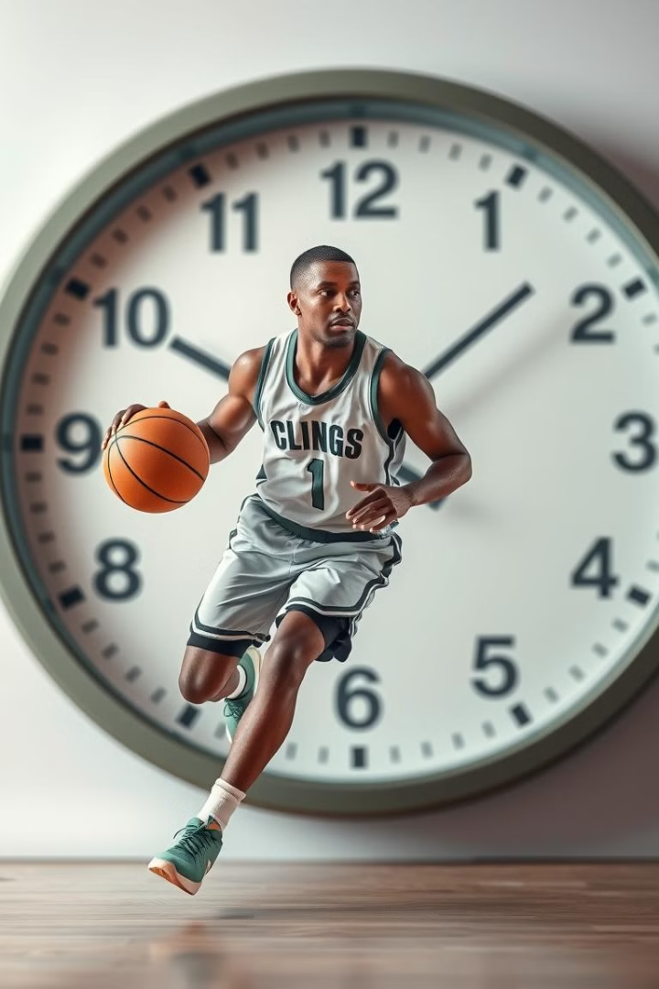
Key Constraints
1
Design Constraints
2
Business Client
The interface simulates bidding given player stats, team needs, and available budget.
Basketball teams can use the interface to simulate drafts to best prepare for actual drafts.

Slide 4




Bidding Mechanics and Workflows
Initial Bid
Teams submit budget constraints, position preferences through the interface, and team order.
Bid Simulation
Teams can simulate the draft and see what players they are more likely to get given their budget, team rank, and player rank.
Evaluation
Teams can evaluate their forecasted outcome and reevaluate team needs or commit to current bidding strategy.

Slide 5
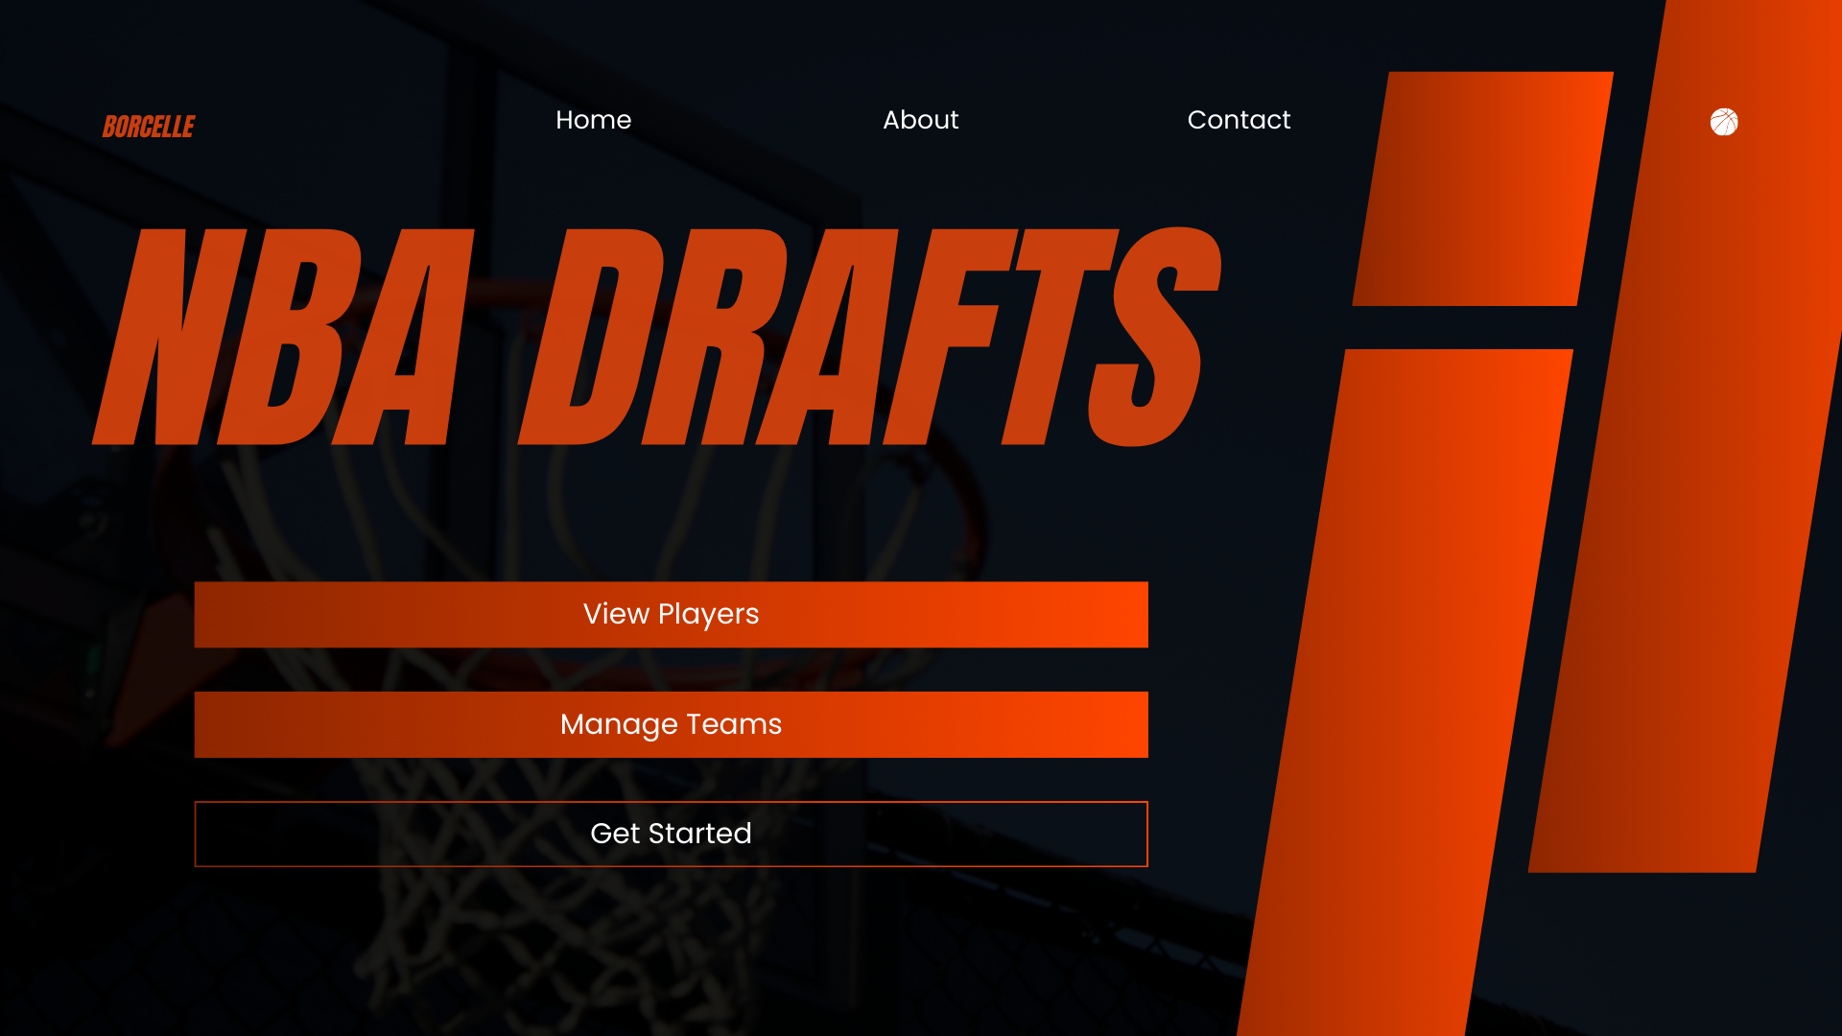

Slide 6
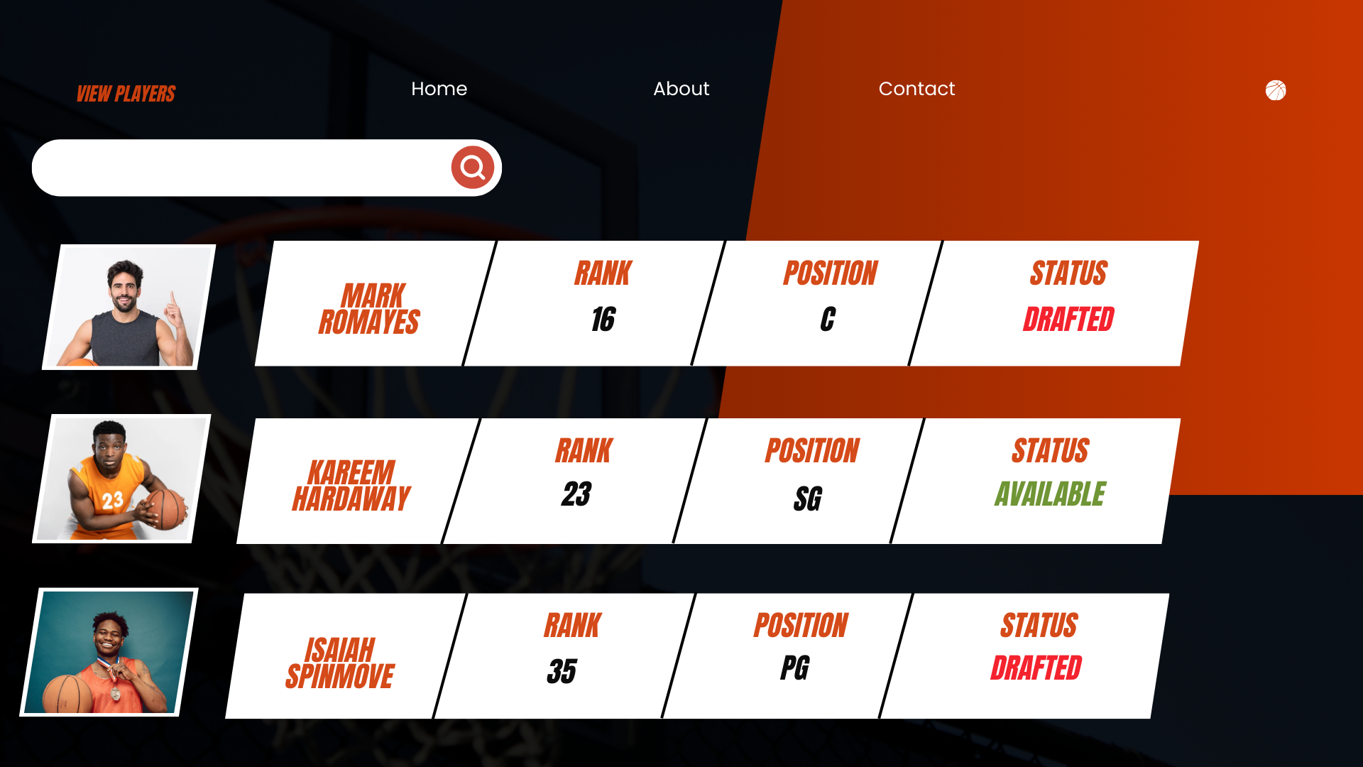

Slide 7
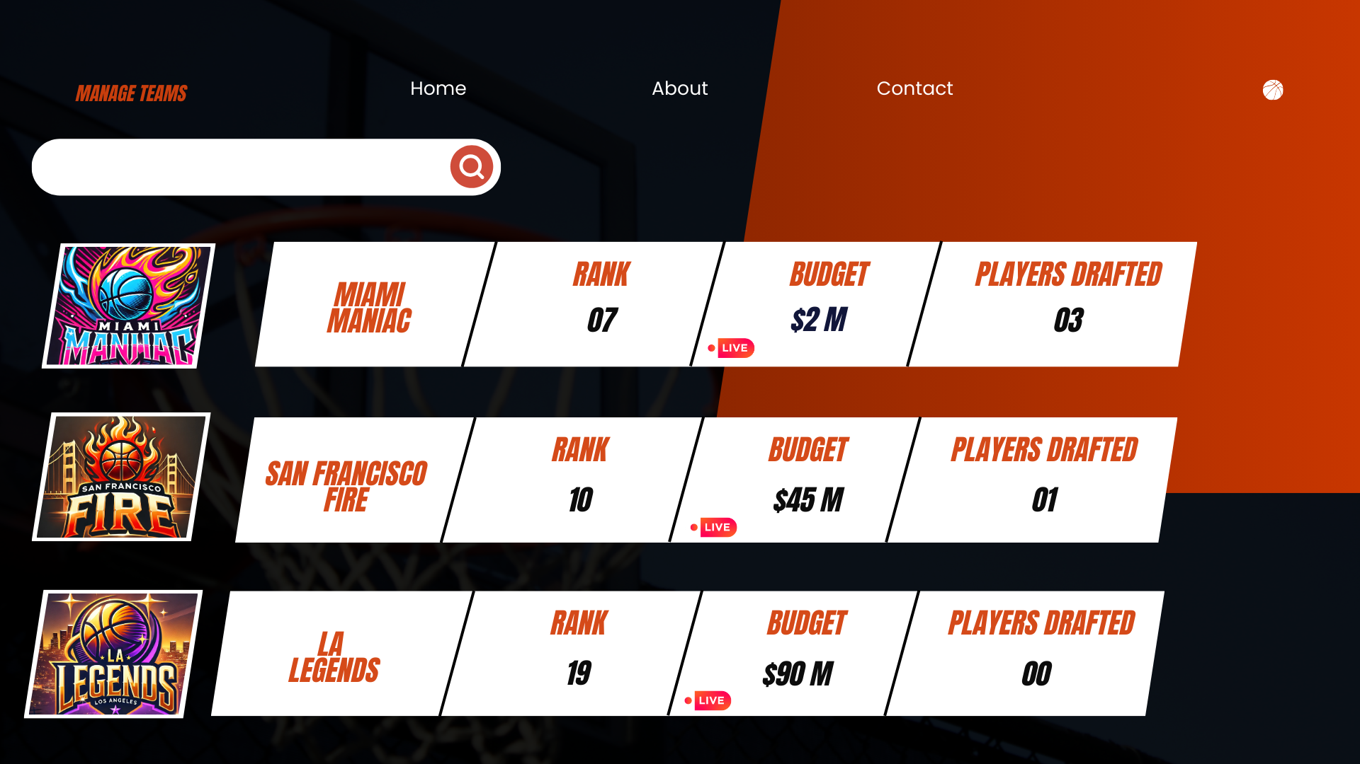

Slide 8
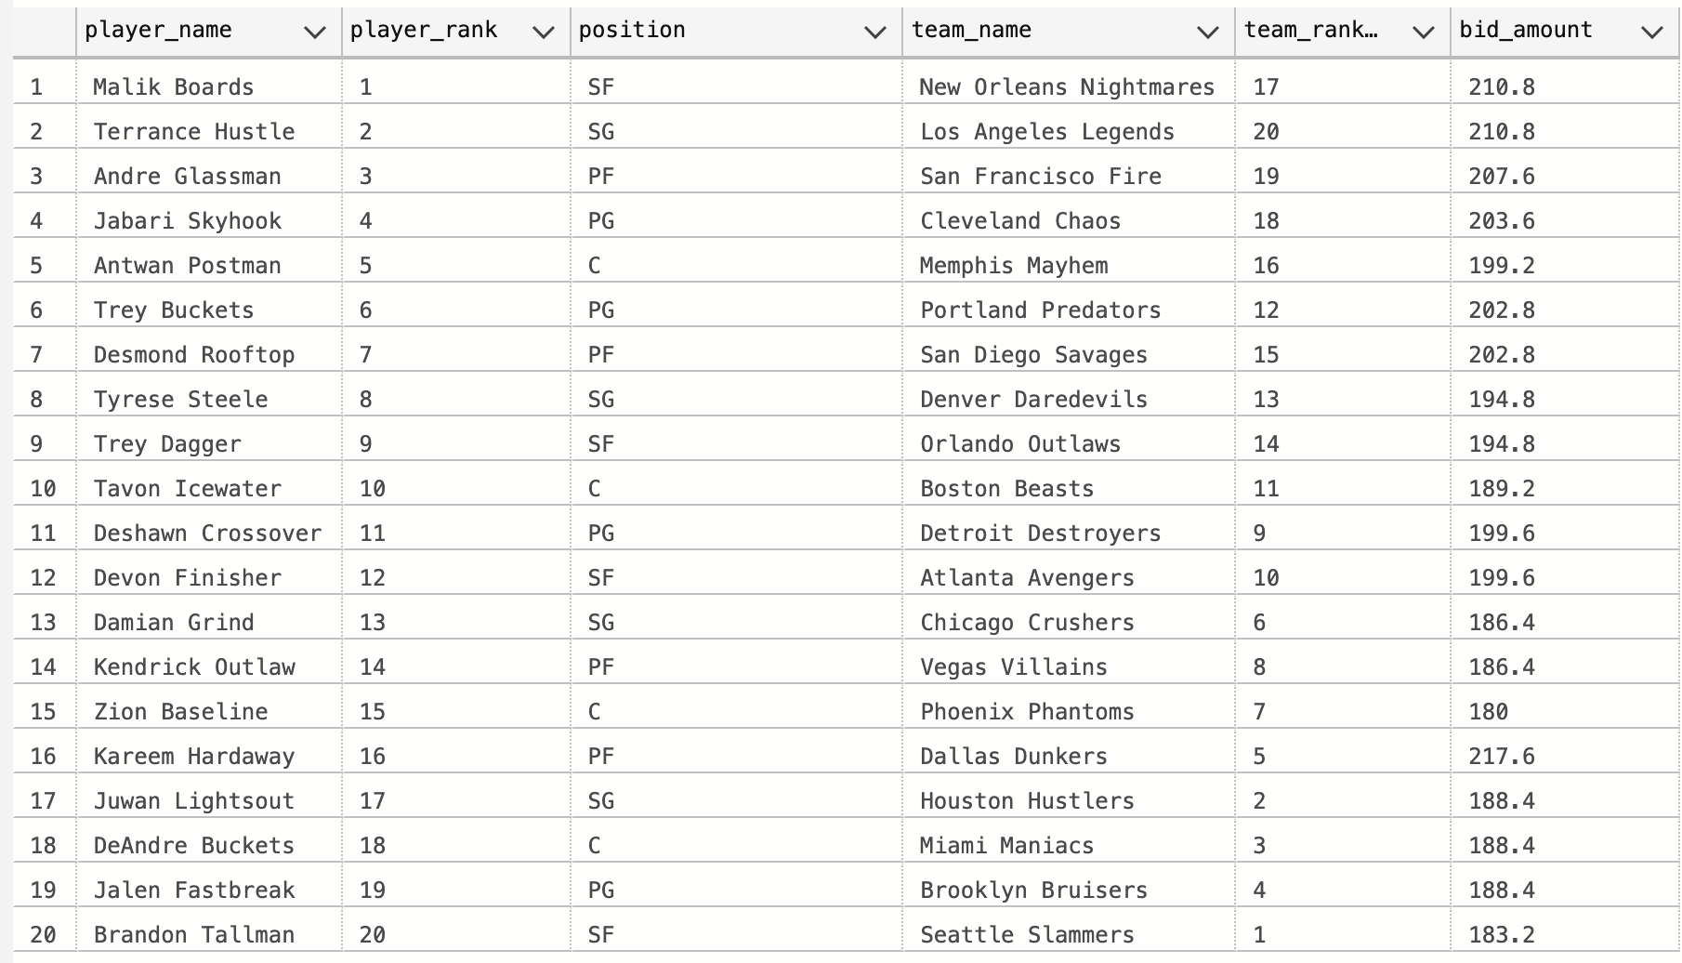
Results

Slide 9

Challenges and Lessons Learned
Simulating
User Experience
The interface must be able to handle a high volume of simultaneous bids during the draft or free agency period.
Balancing user-friendliness with advanced features and functionality was a critical design consideration.

Slide 10

Future Enhancements and Roadmap
1
Advanced Analytics
Integrating advanced analytics to provide deeper insights into player performance and potential.
2
AI-Powered Recommendations
Using AI algorithms to recommend players based on team needs and budget constraints.
3
Implementing Game Theory
Make the simulated teams bidding behavior more complex.

